Slide 1
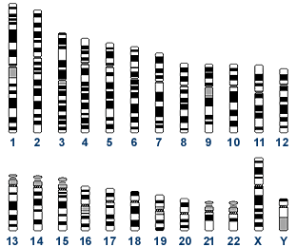
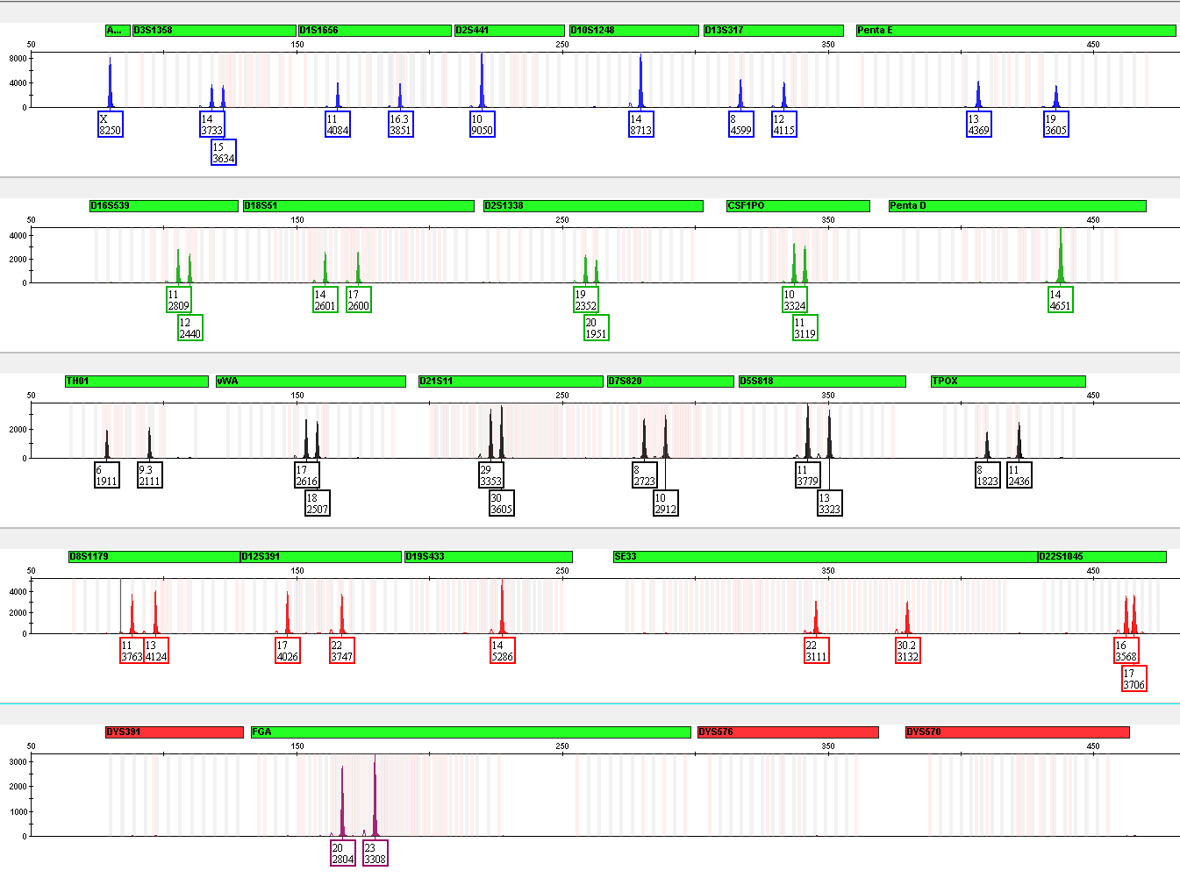
The Basics of STR Typing
http://www.ncbi.nlm.nih.gov/genome/guide/
1 2 3 4 5 6 7 8 9 10 11 12
13 14 15 16 17 18 19 20 21 22 X Y
Notes:
Welcome to the Basics of STR Typing Training Module.

Slide 2
The Human Genome
Nuclear DNA - Located in cell nucleus
Autosomes
2 copies per cell
Located in mitochondria
(multiple copies
in cell cytoplasm)
mtDNA
16,569 bp
http://www.ncbi.nlm.nih.gov/genome/guide/
Only single copy of each autosome shown
John M. Butler (2009) Fundamentals of Forensic DNA Typing, Figure 2.3
1 2 3 4 5 6 7 8 9 10 11 12
mtDNA
13 14 15 16 17 18 19 20 21 22 X Y
Sex-chromosomes
100s of copies per cell
3.2 billion bp
Notes:
The human genome contained in every cell consists of 23 pairs of chromosomes and a small circular genome known as mitochondrial DNA. Chromosomes 1–22 are numbered according to their relative size and occur in single copy pairs within a cell’s nucleus with one copy being inherited from one’s mother and the other copy coming from one’s father. Sex-chromosomes are either X,Y for males or X,X for females. Mitochondrial DNA is inherited only from one’s mother and is located in the mitochondria with hundreds of copies per cell. Together the nuclear DNA material amounts to over three billion base pairs while mitochondrial DNA is only about 16,569 base pairs in length.

Slide 3
What is a DNA Profile?
Human Genome 23 Pairs of Chromosomes
Unique regions of the human genome are targeted
These regions consist of a few hundred base pairs
The regions are copied by the polymerase chain reaction (PCR) – billions of exact copies
The copied fragments now contain fluorescent dyes for detection
http://www.ncbi.nlm.nih.gov/genome/guide/
1 2 3 4 5 6 7 8 9 10 11 12
13 14 15 16 17 18 19 20 21 22 X Y
Nuclear DNA
3.2 billion bp
Butler, J.M. (2005) Forensic DNA Typing, 2nd Edition, Figure 2.3, ©Elsevier Science/Academic Press
Notes:
Unique regions of the human genome across the 23 pairs of chromosomes are targeted and these are referred to as DNA markers. These regions are relatively short and consist of only a few hundred base pairs. These targeted regions, or markers, are copied by the polymerase chain reaction (PCR) and result in billions of exact copies. The copied fragments now contain fluorescent dyes for detection via capillary electrophoresis.

Slide 4
Short Tandem Repeat (STR) Markers
An accordion-like DNA sequence that occurs between genes
TCCCAAGCTCTTCCTCTTCCCTAGATCAATACAGACAGAAGACAGGTGGATAGATAGATAGATAGATAGATAGATAGATAGATAGATAGATAGATATCATTGAAAGACAAAACAGAGATGGATGATAGATACATGCTTACAGATGCACAC
= 12 GATA repeats (“12” is all that is reported)
7 repeats
The number of consecutive repeat units can vary between people
8 repeats
9 repeats
10 repeats
11 repeats
12 repeats
13 repeats
Target region
(short tandem repeat)
Notes:
Short Tandem Repeat (STR) Markers are short, accordion-like DNA sequences that occur between genes. The number of consecutive repeating units can vary between people. Different combinations of these repeats are what make us unique individuals and are what provide a power of discrimination when comparing DNA profiles. We have a total of two STR repeat “alleles” at each marker, again one inherited from our mother and the other from our father.

Slide 5
Short Tandem Repeat (STR) Typing
Fluorescent
dye-labeled
primer
STR Repeat Region
5′
3′
1
2
3
4
5
6
(Maternal)
5′
3′
1
2
3
4
5
6
7
8
(Paternal)
forward primer
hybridization region
GATA
reverse primer
hybridization region
(size in bp)
75….80….100….120….140….160….180….200….220….240.…260…..
1000
500
RFUs
6
139bp
DNA Separation and Detection
8
147bp
Notes:
Short Tandem Repeat (STR) typing involves polymerase chain reaction (PCR) amplification of a small amount of DNA into billions of copies. The inherited maternal and paternal strands at each marker are fluorescently dye-labeled so they can be separated by size (in base pairs) and detected using capillary electrophoresis. When looking at the electropherogram, the x-axis is size in base pairs and the y-axis is Relative Fluorescent Units (RFUs) that indicates the intensity of the peaks, or how much DNA is measured. The numbers (in this case the 6 and the 8) corresponds to the number of repeats of each allele at a single STR marker.

Slide 6
Types of STR Repeat Units
YCAII
Requires size based DNA separation to resolve different alleles from one another
~45%
High stutter
Dinucleotide
Trinucleotide
Tetranucleotide
Pentanucleotide
Hexanucleotide
(CA)(CA)(CA)(CA)
(GCC)(GCC)(GCC)
(AATG)(AATG)(AATG)
(AGAAA)(AGAAA)
(AGTACA)(AGTACA)
*Most Common Type
Low stutter
DYS448
Short tandem repeat (STR) = microsatellite = simple sequence repeat (SSR)
<2%
Notes:
There are several types of STR repeat units that can be measured. STR markers can consist of 2 repeating bases, or dinucleotide, and can go up to 6 repeating bases, or hexanucleotide. Di- and Tri- nucleotides generally have much higher stutter than the higher numbers of repeating bases. Stutter results from strand slippage during PCR amplification of the repeat region. The most common type of repeat unit used in human identification or human cell line authentication is a tetranucleotide. Higher numbers of repeating bases units have much lower stutter after PCR amplification but are very uncommon.

Slide 7
Categories for STR Markers
Category | Example Repeat Structure | 13 CODIS Loci
Simple repeats – contain units of identical length and sequence | (GATA)(GATA)(GATA) | TPOX, CSF1PO, D5S818, D13S317, D16S539
Simple repeats with non-consensus alleles (e.g., TH01 9.3) | (GATA)(GAT-)(GATA) | TH01, D18S51, D7S820
Compound repeats – comprise two or more adjacent simple repeats | (GATA)(GATA)(GACA) | VWA, FGA, D3S1358, D8S1179
Complex repeats – contain several repeat blocks of variable unit length | (GATA)(GACA)(CA)(CATA) | D21S11
These categories were first described by Urquhart et al. (1994) Int. J. Legal Med. 107:13-20
Notes:
There are generally four categories for STR markers: simple repeats, simple repeats with non-consensus alleles, compound repeats, and complex repeats. Simple repeats contain units of identical length and sequence. Simple repeats with non-consensus alleles have a base (or more) missing from the repeating unit that results in what is called a microvariant. Compound repeats are comprised of two or more adjacent simple repeats. And finally, complex repeats contain several repeat blocks of variable unit length. In general, the more complex the repeat is, the more polymorphic the marker is.

Slide 8
Position of Forensic STR Markers on Human Chromosomes
13 CODIS Core STR Loci
TPOX
D3S1358
TH01
1997
D8S1179
D5S818
VWA
Core STR Loci for the United States
FGA
D7S820
CSF1PO
AMEL
Sex-typing
D13S317
D16S539
D18S51
D21S11
AMEL
Notes:
This schematic of the human chromosomes highlights in yellow the core forensic STR markers for the United States and are required for entry into the COmbined DNA Index System (CODIS) database since 1997. These are the markers that are included in the commercial STR typing kits that are used for human identification and human cell line authentication. The green markers labeled “AMEL” are for Amelogenin, which is the sex-typing marker used in these commercial typing kits.

Slide 9
The polymerase chain reaction (PCR) is used to amplify STR regions and label the amplicons with fluorescent dyes using marker-specific primers
8 repeats
Locus 1
10 repeats
8 repeats
Locus 2
9 repeats
Capillary Electropherogram
Notes:
The polymerase chain reaction (PCR) is used to amplify multiple STR regions and label the amplicons with fluorescent dyes using marker-specific primers. This allows multiple STR markers to be amplified together in one single multiplex reaction with one DNA sample. If the two are alleles have two different STR repeat numbers, they show up as two peaks which is referred to as “heterozygous”. If the two alleles have the same number of STR repeat numbers, they show up as one peak that is double the height than if they were separate which is referred to as “homozygous”.

Slide 10
PCR Product Size (bp)
TH01
TPOX
D7
CSF
D19
D3
D21
D13
D16
D2
AMEL
D8
D5
VWA
D18
Allelic Ladder
FGA
DNA Size (bp)
6FAM™ (blue)
D8S1179
D21S11
D7S820
CSF1PO
1 in 837 trillion (probability of this profile occurring at random)
TH01
VIC™ (green)
D3S1358
D13S317
D16S539
D2S1338
Sample
TPOX
NED™ (yellow)
D19S433
VWA
D18S51
Measurement (genotype determination) is performed by comparing allele size (relative to an internal size standard) to a commercially provided STR kit allelic ladder with calibrated repeat numbers (sized according to the same internal size standard)
AMEL
D5S818
PET™ (red)
FGA
An internal size standard is run with each sample and external standard to correlate sizes.
GS500 LIZ size standard (not shown above)
LIZ™ (orange)
Notes:
An STR profile is achieved through capillary electrophoresis (CE) and consists of several markers together in a single multiplex reaction. The markers are separated by size and are dye-labeled with different fluorescent colors that are detected by the genetic analyzer instrument. Genotype determination is performed by comparing allele size relative to an internal size standard to a commercially provided STR kit allelic ladder with calibrated repeat numbers. These profiles produce a string of numbers that can be entered into the database.

Slide 11
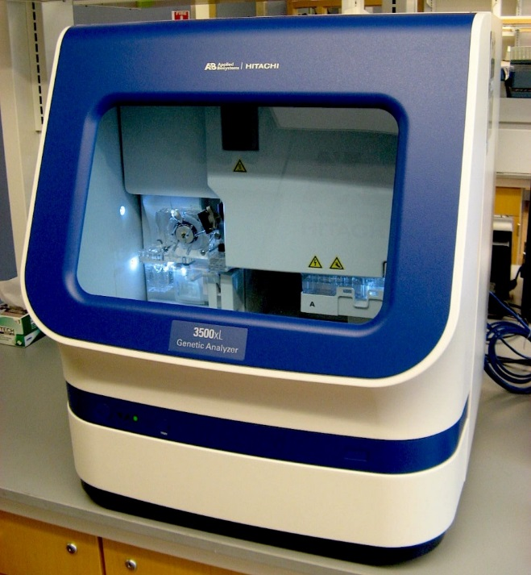
Capillary Electrophoresis
A Genetic Analyzer is used to separate PCR products by fragment length
Samples migrate through an electric field
Negatively charged DNA migrates toward the anode
Keeping DNA single stranded allows all same sized fragments to migrate together
Single stranded fragments pass through a laser, exciting a dye-labeled primer
Detector captures the intensity of the dye
Multiplexing capabilities for DNA fragment analysis with up to six unique dyes
Sample preparation:
Samples are prepared using formamide and an Internal Size Standard (ISS). An allelic ladder is run in a separate lane
Notes:
A Genetic Analyzer is used to separate PCR products by fragment length via capillary electrophoresis. The amplified DNA products migrate through an electric field where the negatively charged DNA migrates toward the anode on the instrument. Because single stranded DNA is injected into the capillaries, this allows all the same sized fragments to migrate together. These single stranded fragments pass through a laser that excites the fluorescent dye-labeled primer. The detector camera captures the intensity of the dye and records the sizing information for data analysis. Multiplexing capabilities with the newest instruments allows DNA fragment analysis with up to six unique dyes. Samples are prepared by adding a small amount of the amplicon to formamide and an Internal Size Standard. An allelic ladder is run in a separate lane.

Slide 12
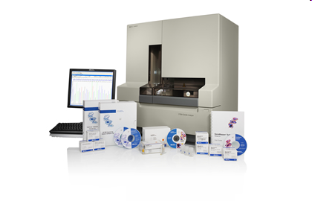
Capillary Electrophoresis
Fill with Polymer Solution
Argon Ion Laser
The labeled fragments are separated (based on size) and detected on a capillary electrophoresis instrument
Less than an hour
LASER
50-100 µm x 27 cm
-
Burn capillary window
+
DNA Separation occurs in ~30 - 40 minutes...
Fragment size ranges from 100 - 350 base pairs
Inlet (cathode)
Outlet (anode)
5-20 kV
Peaks represent labeled DNA fragments separated by electrophoresis
This ‘profile of peaks’ is unique for an individual – a DNA type
Data Acquisition and Analysis
Notes:
In capillary electrophoresis, the polymer gets heated to reduce viscosity. Electrodes come down into the samples, and the now charged samples travel into the capillary. The probes are excited by an argon ion laser and a CCD camera captures the image and detects fluorescence. The size of the fragment is based on fluorescent intensity. Software is used to determine number of bases (fragment length) and results in a profile of peaks, or DNA type. This process occurs in less than an hour.

Slide 13
STR Typing Data Analysis
The data files that are generated from the instruments are typically in a .fsa or .hid format
These data files are then imported into the Data Analysis Software
GeneMapper ID or ID-X (Thermo Fisher)
GeneMarker (SoftGenetics)
OSIRIS (NCBI)
DNA profiles can then be entered into the database of interest
CODIS (human identification)
ATCC, DSMZ, NCBI Biosample (human cell line authentication)
Notes:
The data is collected by the Data Collection Software and are generated into data files that can be analyzed. The output data files are typically in a .fsa or .hid format. These data files are then imported and analyzed into the Data Analysis Software which can be GeneMapper ID or ID-X, GeneMarker or OSIRIS. Once the DNA profiles are determined, they can be entered into the database of interest.

Slide 14
The STR Markers
Markers required for STR genotyping of human cell lines
Minimum of 8 STR loci
D5S818
D13S317
D7S820
D16S539
vWA
TH01
TPOX
CSF1PO
Gender determination marker
Amelogenin (AMEL)
TPOX
TH01
D5S818
VWA
D7S820
CSF1PO
AMEL
D13S317
D16S539
AMEL
Notes:
There are a minimum of 8 STR loci plus the gender determination marker Amelogenin (Amel) that are required by the current ANSI Standard (ASN-0002) for STR genotyping of human cell lines. These 8 markers plus Amelogenin are found in all currently available commercial STR multiplex kits. In fact, most of the current kits have a minimum of 15 STR markers plus Amelogenin and the largest kit has a total of 27 markers.

Slide 15
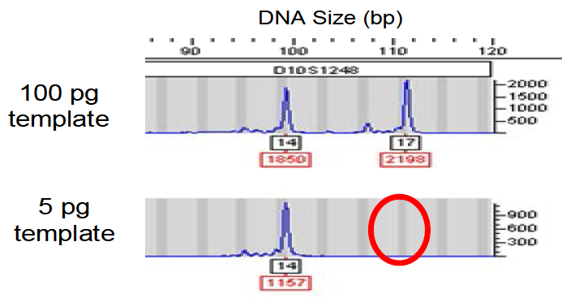
Quality of STR Profile
Assignment of allele calls
Appropriate peak height/peak threshold
Allelic drop out or stochastic effects due to
Low DNA concentration in sample
Inhibitors present in PCR reaction
Mutation in primer binding site
Peak imbalance in tumor cell lines due to aneuploidy or deletion
Overcome stochastic effects by
Increasing DNA template in reaction
Increasing the number of cycles in the PCR program
Check template DNA for contaminants
Recommended to amplify DNA at two different template concentrations to confirm peak imbalance
Detection of microvariants and off-ladder alleles
Notes:
The quality of STR profile is determined once the assignment of allele calls is made by the analysis software. The software applies the appropriate threshold determined from instrument and STR kit validation studies. Allelic drop out or stochastic effects can be due to low DNA concentration used in the PCR reaction, inhibitors present in the PCR reaction, a primer binding site mutation, or peak imbalance in tumor cell lines due to aneuploidy or deletion. These stochastic effects can be overcome by increasing the DNA template in the reaction, increasing the number of cycles in the PCR program and checking the DNA template for contaminants using quantitative PCR (qPCR). In some profile, microvariants or off-ladder alleles can occur so these must be reviewed carefully, as well as PCR artifacts such as stutter or incomplete adenylation.

Slide 16
Summary and Final Thoughts
Short Tandem Repeat (STR) typing is an accurate and highly discriminatory method for human identification and human cell line authentication
STR markers are highly variable regions of the genome targeted with Polymerase Chain Reaction (PCR) amplification
DNA profiles are generated through capillary electrophoresis and can be entered into DNA databases of interest
There are 8 STR loci plus Amelogenin that are required by the current ANSI Standard (ASN-0002) for STR genotyping of human cell lines
Based on available data it appears that 8 STR markers plus amelogenin may not be enough to discriminate between closely related cell lines
There are additional STR markers available and present in more recent and larger commercial STR multiplex kits
Notes:
In summary, STR typing is an accurate and highly discriminatory method for human identification and human cell line authentication. STR markers are highly variable regions of the genome targeted with PCR amplification. DNA profiles are generated through capillary electrophoresis and can be entered into DNA databases of interest. And finally, there are 8 STR loci plus Amelogenin that are required by the current ANSI Standard (ASN-0002) for STR genotyping of human cell lines; however, based on available data it appears that 8 STR markers may not be enough to discriminate between closely related cell lines. There are additional STR markers available and present in more recent and larger commercial STR multiplex kits.

